Slide 1
Bringing research to life
Innovation to facilitate data sharing in the life sciences and biomedicine
NAOMI PENFOLD Innovation Officer
Notes:
Good afternoon everyone. My name is Naomi. I am a biologist by training and transitioned from academia to work at eLife, because I share their vision of making research more transparent and collaborative. Today, I’d like to talk about innovation happening to facilitate data sharing in biology. I’ll outline some of the benefits of sharing data in biology, address the current state of ‘open’ data, and spend some time showcasing new tools and technologies that are making it possible to bring research data and the narrative to life through the research publication. I’d like to ensure we have plenty of time at the end to discuss your thoughts and ideas too.

Slide 2

Slides available at
https://github.com/npscience/csvconfv3-presentation
This work is licensed under a Creative Commons Attribution 4.0 International License.
Notes:
The slides today can be found online at this URL (any exceptions?)

Slide 3
About eLife
@eLifeInnovation
innovation@elifesciences.org
Notes:
To set the scene, let me tell you a little about eLife

Slide 4

eLife is a non-profit organisation inspired by research funders and led by scientists
Notes:
eLife is a collaboration between working scientists and these research funders

Slide 5
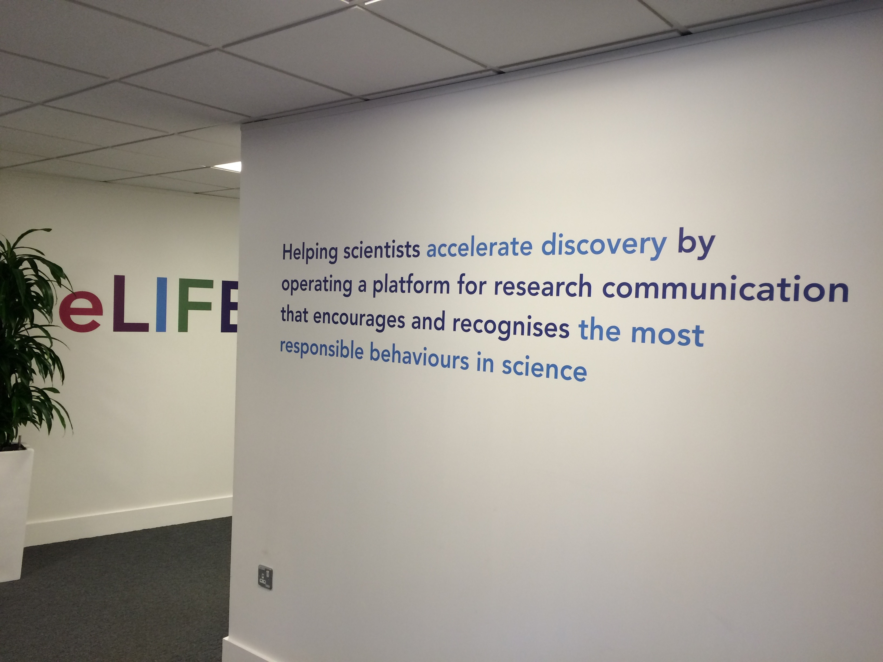
Notes:
The organisation was founded five years ago to address the frustrating delay between making a discovery and communicating that work as an academic, and to help researchers to work more collaboratively and transparently. We operate the online open-access journal, eLife, for advances in life sciences and biomedicine.

Slide 6
eLife Innovation Initiative
We invest in open source technologies, tools and processes that improve the way cutting-edge research is discovered, shared, consumed and evaluated
Notes:
Through the leverage that the journal gives us, we are working to bring about change in research communication. One of the ways we do this is by actively championing new tools and technologies that help researchers discover, share, consume and evaluate the latest research. Specifically, we are committed to open-source development – both with the technologies we are develop ourselves, and with the tools that the community develop and we showcase and support. Why? Because we are looking to effect wide-reaching change, with any technology we develop or support available for other journals and stakeholders to benefit from and build on.

Slide 7
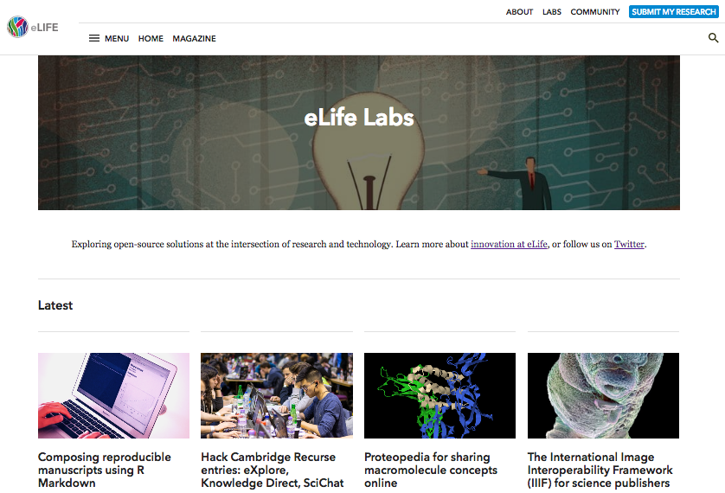
eLife Labs
Notes:
You can explore the tools showcase at eLife Labs (URL in bottom left: elifesciences.org/labs) – featuring guest blogs from project developers, helping to bring these ideas to a wider audience.

Slide 8

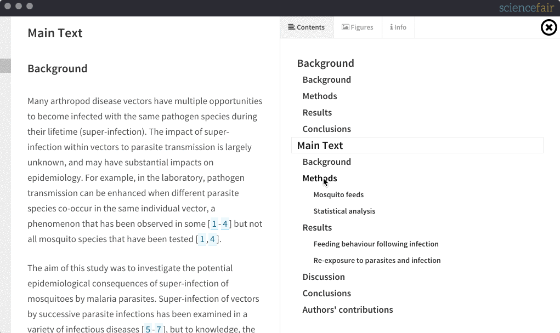
ScienceFair
https://github.com/codeforscience/sciencefair
Notes:
We also support the development of some tools –for example, we are currently supporting Richard Smith-Unna to develop ScienceFair – a desktop application for discovering and reading research articles offline in an alternative format to the pdf layout. We heard that Richard had been tinkering with this idea in his spare time, and we are pleased to now be funding the development of the prototype.

Slide 9
Ideas?
Email Naomi at innovation@elifesciences.org
Notes:
My role at eLife is to scout out innovations within our remit that we may be able to help showcase to prospective users, or even support the development of. I welcome anyone here who has ideas or projects that you feel could help us to improve research communication, to catch me later, or even reach out by email afterwards

Slide 10
Why share data+ ?
@eLifeInnovation
innovation@elifesciences.org
Notes:
Now I’ve set the scene for our interest in this topic, I’d like to explore why we promote data sharing data? I’ve written data + here, in appreciation of the other assets that make open data useful, including the code used to visualise and analyse the data.

Slide 11
“If I have seen further,
it is by standing
on the shoulders of giants”
Isaac Newton
Notes:
A key underlying principle of science is encapsulated in this quote form Isaac Newton: the best science is not conducted in isolation. Scientists make advances by building on the work of others. This is only possible if that work is communicated widely, clearly and completely

Slide 12
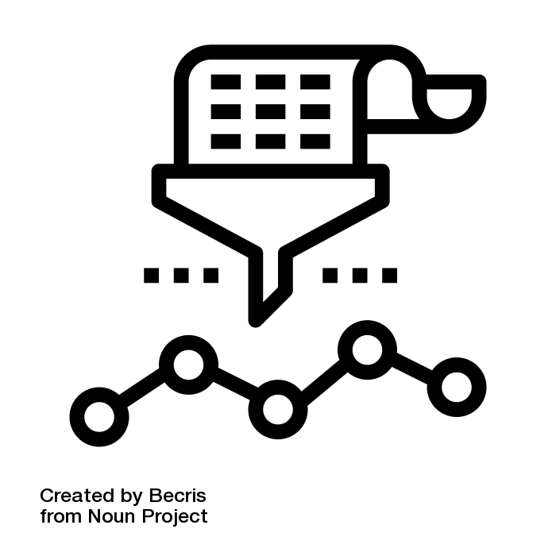
“Show me the evidence”
Notes:
Not only this but it is important can show the evidence to back up their claims. It is important that each observation can be replicated, each result can be reproduced, in order to move towards a greater sense of reproducibility in the sciences.
CC-BY 3.0 https://thenounproject.com/search/?q=analysis&creator=1589329&i=544628

Slide 13
“True science thrives best
in glass houses, where
everyone can look in”
Max Perutz
Notes:
Max Perutz said true science thrives best in glass houses, Similarly to how open source code development helps the software industry to improve quality and make advances more quickly than when code is kept privately, we would like for researchers to be able to share their work more openly and completely, to allow the research community to make discoveries more quickly and efficiently. Opening up data, code and other assets also means that people can do things with these resources that the original creator may not have time for, the skills to do, or even the idea to do.

Slide 14
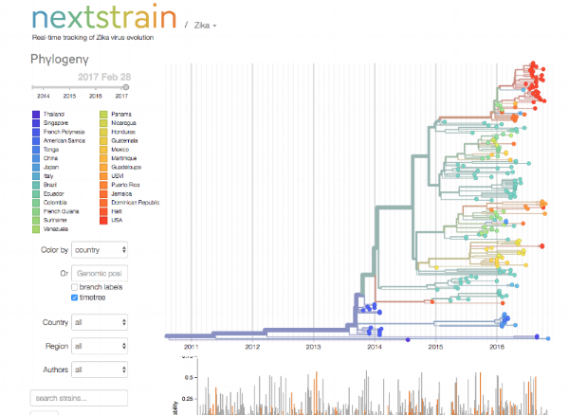
Sharing data accelerates discovery and innovation
Notes:
In genetics, data sharing has become commonplace, helped by initiatives like the Human Genome Project, which showed the value of sharing datasets rapidly after collection rather than waiting for publication. The abundance of open data in genetics makes tolls like Next Strain possible. Next Strain is the project that recently won the Open Science Prize. It builds on genetic sequencing data for viruses that present an epidemic threat, including zika and ebola, by showing how these viruses are evolving, and which countries they are presenting in, in real-time. This information sharing brings great value to for helath organisations, policymakers, and citizens alike.

Slide 15
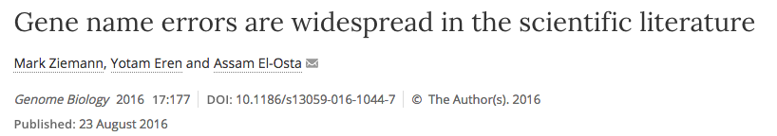
Sharing data allows community to spot problems…
‘SEPT2’ (Septin 2) → ‘2-Sep’
‘2310009E13’ (RIKEN identifier) → ‘2.31E+13’
1 in 5
Notes:
Sharing data also allows the community to spot problems. For instance, it as reiterated last year that genetic datasets prepared in Excel are vulnerable to the autocorrect function, which replaces gene names like SEPT2 with dates (September 2), and mistakes gene identifiers like this one for floating point numbers. This error has been found to affect datasets behind 1 in 5 genetics papers, and may have affected the interpretation of these data. Having the data available means the vulnerability has been identified and the problem can now be addressed by the community.

Slide 16

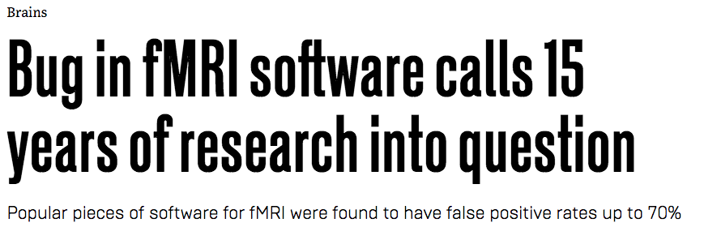

…and adjust with advancements
Notes:
the value of open data becomes really apparent when it is absent: when a software that was widely used to analyse neuroimaging data was reported (in PNAS) to contain a bug last year, there was little the community could do to check and correct past research results, since arching and data-sharing practises in this community were said to be “lamentable” and that “it [was] unlikely any problematic analyses can be redone.”
Reported in PNAS
original report called into question 40,000 studies; article since corrected to present a less dramatic number
“These results question the validity of a number of fMRI studies and may have a large impact on the interpretation of weakly significant neuroimaging results.”

Slide 17
The state of Open Data
@eLifeInnovation
innovation@elifesciences.org
Notes:
Those are just a few examples to illustrate the pertinence of the open data conversations to biology, and the value that improving data sharing could bring to global health through biomedical research as well asto our understanding of how our minds and bodies work. So how are we doing with open data practises in biology?

Slide 18
Open… and FAIR?
F Findable
A Accessible
I Interoperable
R Re-usable
https://www.force11.org/group/fairgroup/fairprinciples
Notes:
It’s important to note that when we talk about data sharing, we’re not just talking about making a dataset open-access, but also findable, accessible, interoperable and reusable – i.e. it has to be usefully open.
Findable – identifier, metadata, indexed
Accessible – retrievable using the identifier, metadata is findable even when data is not
Interoperable – use a format and language that can be used by others
Reusable – license, provenance, community standards
And this is for both humans and machines
---
To be Findable:
F1. (meta)data are assigned a globally unique and eternally persistent identifier.
F2. data are described with rich metadata.
F3. (meta)data are registered or indexed in a searchable resource.
F4. metadata specify the data identifier.
To be Accessible:
A1 (meta)data are retrievable by their identifier using a standardized communications protocol.
A1.1 the protocol is open, free, and universally implementable.
A1.2 the protocol allows for an authentication and authorization procedure, where necessary.
A2 metadata are accessible, even when the data are no longer available.
To be Interoperable:
I1. (meta)data use a formal, accessible, shared, and broadly applicable language for knowledge representation.
I2. (meta)data use vocabularies that follow FAIR principles.
I3. (meta)data include qualified references to other (meta)data.
To be Re-usable:
R1. meta(data) have a plurality of accurate and relevant attributes.
R1.1. (meta)data are released with a clear and accessible data usage license.
R1.2. (meta)data are associated with their provenance.
R1.3. (meta)data meet domain-relevant community standards.

Slide 19
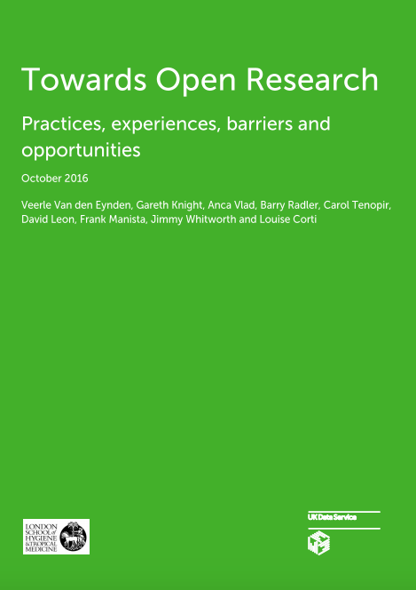
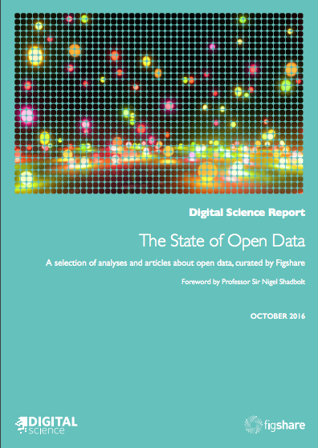
Recent surveys
Van den Eynden, Veerle et al. (2016) Towards Open Research: Practices, experiences, barriers and
opportunities. Wellcome Trust. https://dx.doi.org/10.6084/m9.figshare.4055448
Treadway, Jon; Hahnel, Mark; Leonelli, Sabina; Penny, Dan; Groenewegen, David; Miyairi, Nobuko; Hayashi, Kazuhiro; O'Donnell, Daniel; Science, Digital; Hook, Daniel (2016): The State of Open Data Report. figshare.
https://doi.org/10.6084/m9.figshare.4036398.v1
Notes:
According to two surveys reported last year from the Wellcome Trust, and Figshare about attitudes and practises amongst life sciences researchers

Slide 20
73% of biologists aware
Notes:
Three-quarters of biologists are aware of open data, and what that means

Slide 21
50% make data available
Notes:
50% do make their research data available in some way, although not all is open-access (80%)

Slide 22
25% make full dataset available
Notes:
with only 25% stating that they share the full dataset.
It’s fair to say that not all research data is appropriate to share. We are keen to encourage researchers to share their data as openly as possible, and as closed as appropriate.

Slide 23
Improving data+ sharing
@eLifeInnovation
innovation@elifesciences.org
Notes:
But we think we can do a lot better than the current levels of data sharing and open data quality in biology. Currently, there are insufficient incentives for this sharing. The value of sharing may not be visible, or even directly meaningful, to the individual researcher. Plus, the tools used to collect, structure, and analyse data are not optimised for sharing that data and analysis easily when the researcher is ready to do so. We are interested in innovations that facilitate data and code sharing – let me show you some of the tools and processes available right now.

Slide 24
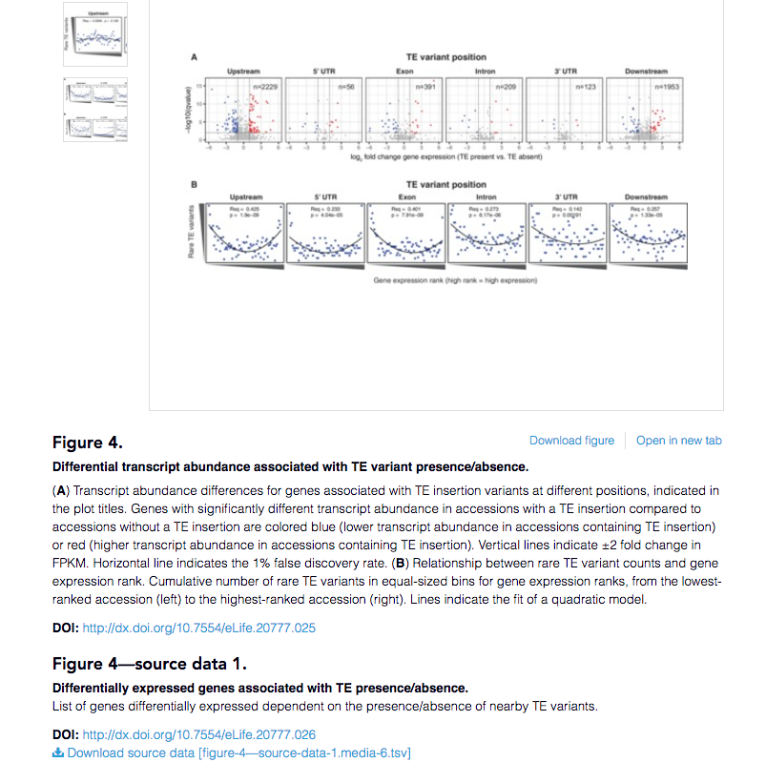
Data sharing policies
Publish
Describe
Interact
Reproduce
Update
Link
Recognise
Notes:
I believe Robin will talk a little more on this next.
Starting with the stick – reputable journals and funders require underlying data for research to be made available via online repositories or with the research publication. At eLife, we give the data its own DOI and we display the link to these data with the relevant figure to make the connection to the source data as clear as possible
--
“eLife requires all major datasets associated with an article to be made freely and widely available (unless there are strong reasons to restrict access, for example in the case of human subjects data), in the most useful formats, and according to the relevant reporting standards”
“Wherever possible, authors should make major datasets available using domain-specific public archives (for example, GenBank, Protein Data Bank, and ClinicalTrials.gov), or generic databases (for example, Dryad, Dataverse, the Open Science Framework or an institutional repository) where a domain-specific archive does not exist. A comprehensive catalogue of databases has been compiled by the BioSharing information resource.”
Author guide
It is journal policy that if you have data that can be shared, it must be. Link to your dataset from the article.
We’re certainly not the only ones to do this; all reputable journals will ask authors to share their source data.

Slide 25


Data publications
Publish
Describe
Interact
Reproduce
Update
Link
Recognise
Notes:
In the past few years, new journals have been set up to give data pride of place in a publication: through GigaScience and Scientific Data, researchers can publish open-access descriptions of their shared datasets, including instructions for reuse. This helps to credit the researchers involved in data preparation as well as increasing the discoverability and reusability of these data.

Slide 26
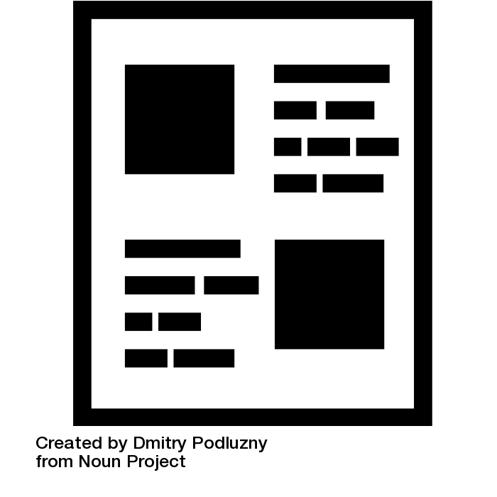
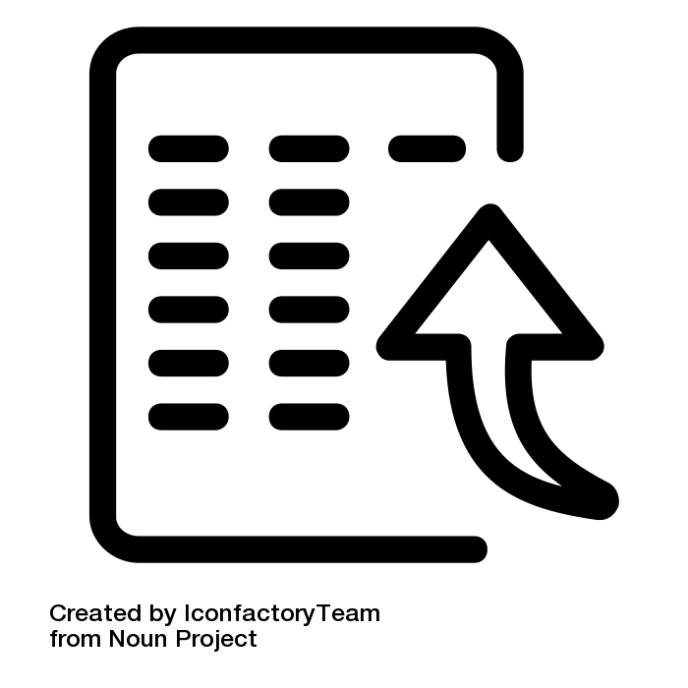
Can we bring the data closer to the narrative?
+
Notes:
But we think we can do even better than incentivising sharing the dataset separate to the narrative. Technology has improved to the point where we can consider integrating the underlying data and code into the research article, in a way that shows the value of more transparent, and reproducible research communication. Also, incorporating the underlying research data into the article in a more dynamic way inherently forces the shared data to be reusable.
Dmitry – CC-BY 3.0 https://thenounproject.com/search/?q=article&creator=109667&i=74762
IconfactoryTeam – CC-BY 3.0 https://thenounproject.com/search/?q=upload&creator=41302&i=603587

Slide 27
The interactive figure
Publish
Describe
Interact
Reproduce
Update
Link
Recognise
Notes:
For example, we can make figures interactive – as shown here on the authoring platform, Authorea
author-defined, built using d3 library
gain a better understanding of the data being presented
can be used to provide different representations of the same data
Authorea and d3.jshttps://www.authorea.com/users/3/articles/3904-data-driven-interactive-science-with-d3-js-plots-and-ipython-notebooks/_show_article

Slide 28
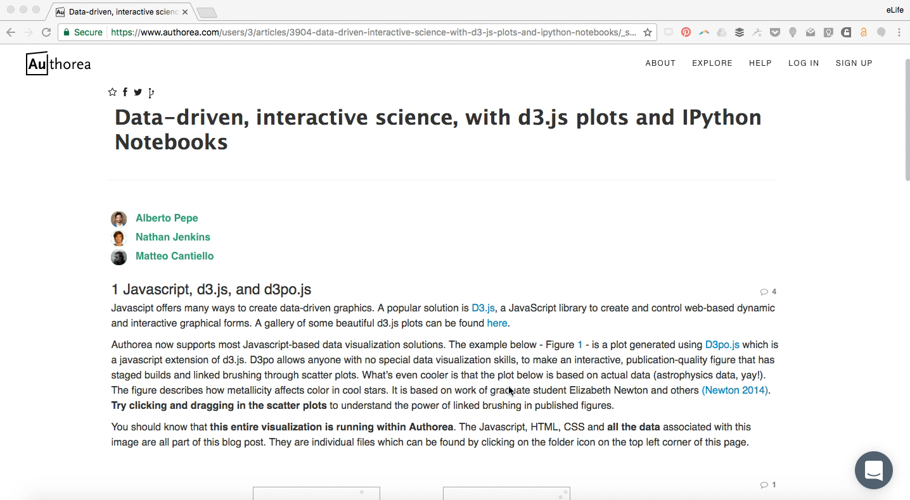
Some steps removed and sequences shortened

Slide 29
The executable figure
Some steps removed and sequences shortened
Publish
Describe
Interact
Reproduce
Update
Link
Recognise
Notes:
Or we could go even further, and make the figures executable using the underlying data and code, also demonstrated on Authorea. This is a little involved, so I’ve done an apple and removed some of the steps required for timing.
plot sat with text in article
launch in a new page the interactive notebook
text, code blocks, and the output. Run this code by clicking shift+enter.
Get to the plot from the article. Can change the script, e.g. I change the axes, and see the results here. You can imagine how more complex interactions could take place through this technology.
Authorea: launch iPython notebook https://www.authorea.com/users/3/articles/3904-data-driven-interactive-science-with-d3-js-plots-and-ipython-notebooks/_show_article

Slide 30
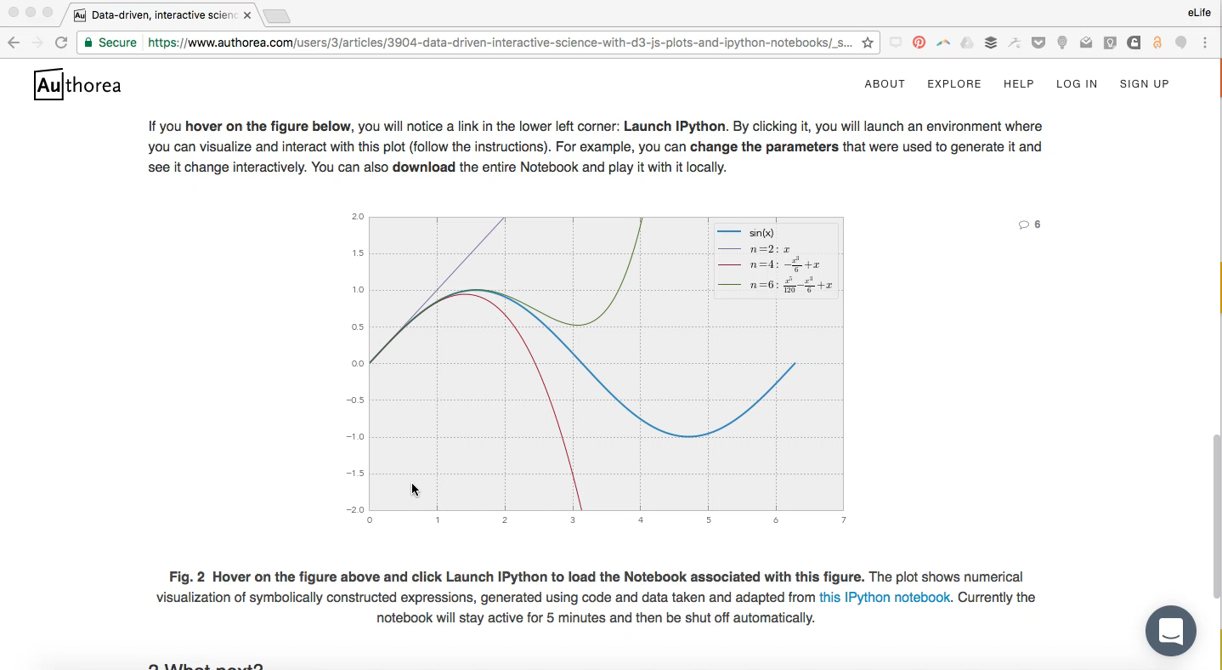
The reproducible figure
Some steps removed and sequences shortened
Notes:
Authorea

Slide 31
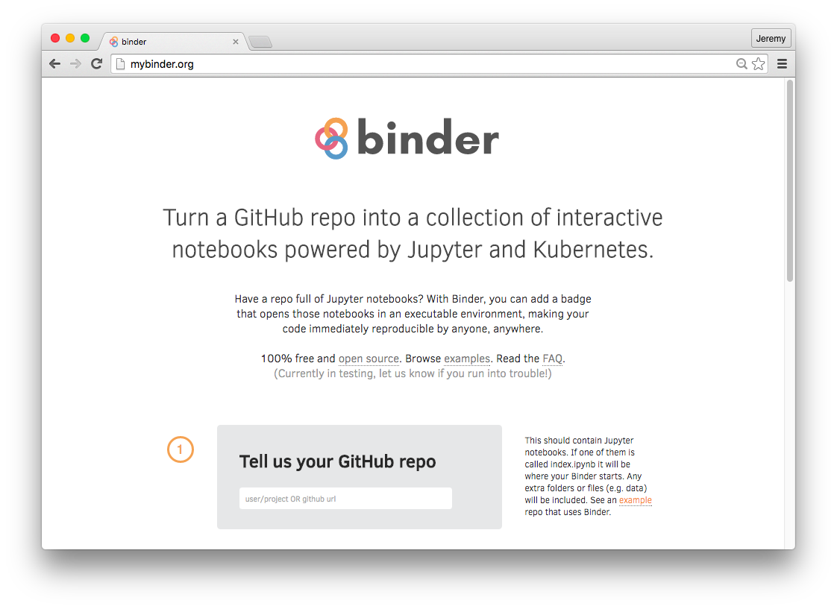
Notes:
Binder is a service that makes it easier for authors to deploy their own executable project based on the data, code and notebooks in their github repository, and using Docker containers. Users are able to then launch the binder in their own browser, much like what I’ve just shown, Binder was developed by researchers at Janelia Research Campus last year, and you can find out more about it through their guest blog on eLife Labs.
What I find really exciting about reproducible research documents is that by enforcing reusability of the data, this could drive up the quality of shared data.

Slide 32
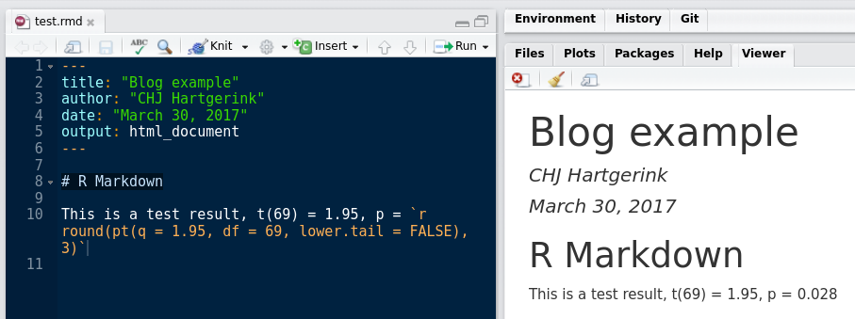
The reproducible document
Publish
Describe
Interact
Reproduce
Update
Link
Recognise
Notes:
Integrating data and code into the research publication can go beyond the producing the plots – we recently featured R Markdown on the blog, with Chris Hartgerink explaining how researchers can hard code their statistical results into their manuscripts. No more human errors from copying and pasting in results from stats software, and this workflow also makes it much easier to add to your manuscript when new data becomes available.

Slide 33
“It took me a couple of hours to…
REPRODUCE EXACTLY the analysis presented in the manuscript... With few more hours, I was able to modify the authors’ code
to change a linear scale for a log scale for their Fig. 4.”
Christophe Pouzat, reviewer GigaScience blog: http://gigasciencejournal.com/blog/qa-on-dynamic-documents
Publish
Describe
Interact
Reproduce
Update
Link
Recognise
Notes:
In fact, when Stephen Eglen published a data publication in GigaScience in 2014, he had written the manuscript in R Markdown and supplied that file with his submission. The reviewers downloaded it and re-ran the analysis on their own machines – not only were the reviewers able to reproduce his results, but one even modified the axis for one of the plots as a suggested revision.
When Stephen Eglen et al. submitted their manuscript with all the supporting data and code for
For paper:
Stephen John Eglen, Michael Weeks, Mark Jessop, Jennifer Simonotto, Tom Jackson, Evelyne Sernagor; A data repository and analysis framework for spontaneous neural activity recordings in developing retina. Gigascience 2014; 3 (1): 1-12. doi: 10.1186/2047-217X-3-3
Source: GigaScience blog - http://gigasciencejournal.com/blog/qa-on-dynamic-documents/

Slide 34

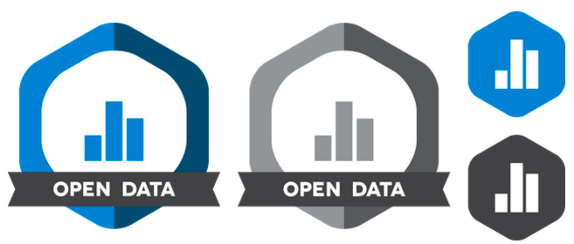
Credit
Publish
Describe
Interact
Reproduce
Update
Recognise
Link
Notes:
Recognising researchers who share their data will be vital for broader adoption. The Centre for Open Science has created an open data badge, that sits with the publication to highlight where underlying datasets are available. Some have questioned whether this badge approach is an effective way to incentivise researchers.
---
The Open Data badge is earned for making publicly available the digitally-shareable data necessary to reproduce the reported results.
Criteria
Digitally-shareable data are publicly available on an open-access repository. The data must have a persistent identifier and be provided in a format that is time-stamped, immutable, and permanent (e.g., university repository, a registration on the Open Science Framework, or an independent repository at www.re3data.org).
A data dictionary (for example, a codebook or metadata describing the data) is included with sufficient description for an independent researcher to reproduce the reported analyses and results. Data from the same project that are not needed to reproduce the reported results can be kept private without losing eligibility for the Open Data Badge.
An open license allowing others to copy, distribute, and make use of the data while allowing the licensor to retain credit and copyright as applicable. Creative Commons has defined several licenses for this purpose, which are described at www.creativecommons.org/licenses. CC0 or CC-BY is strongly recommended.
Also badges for open methods, pre-registration, and a reproducibility badge is being considered.

Slide 35
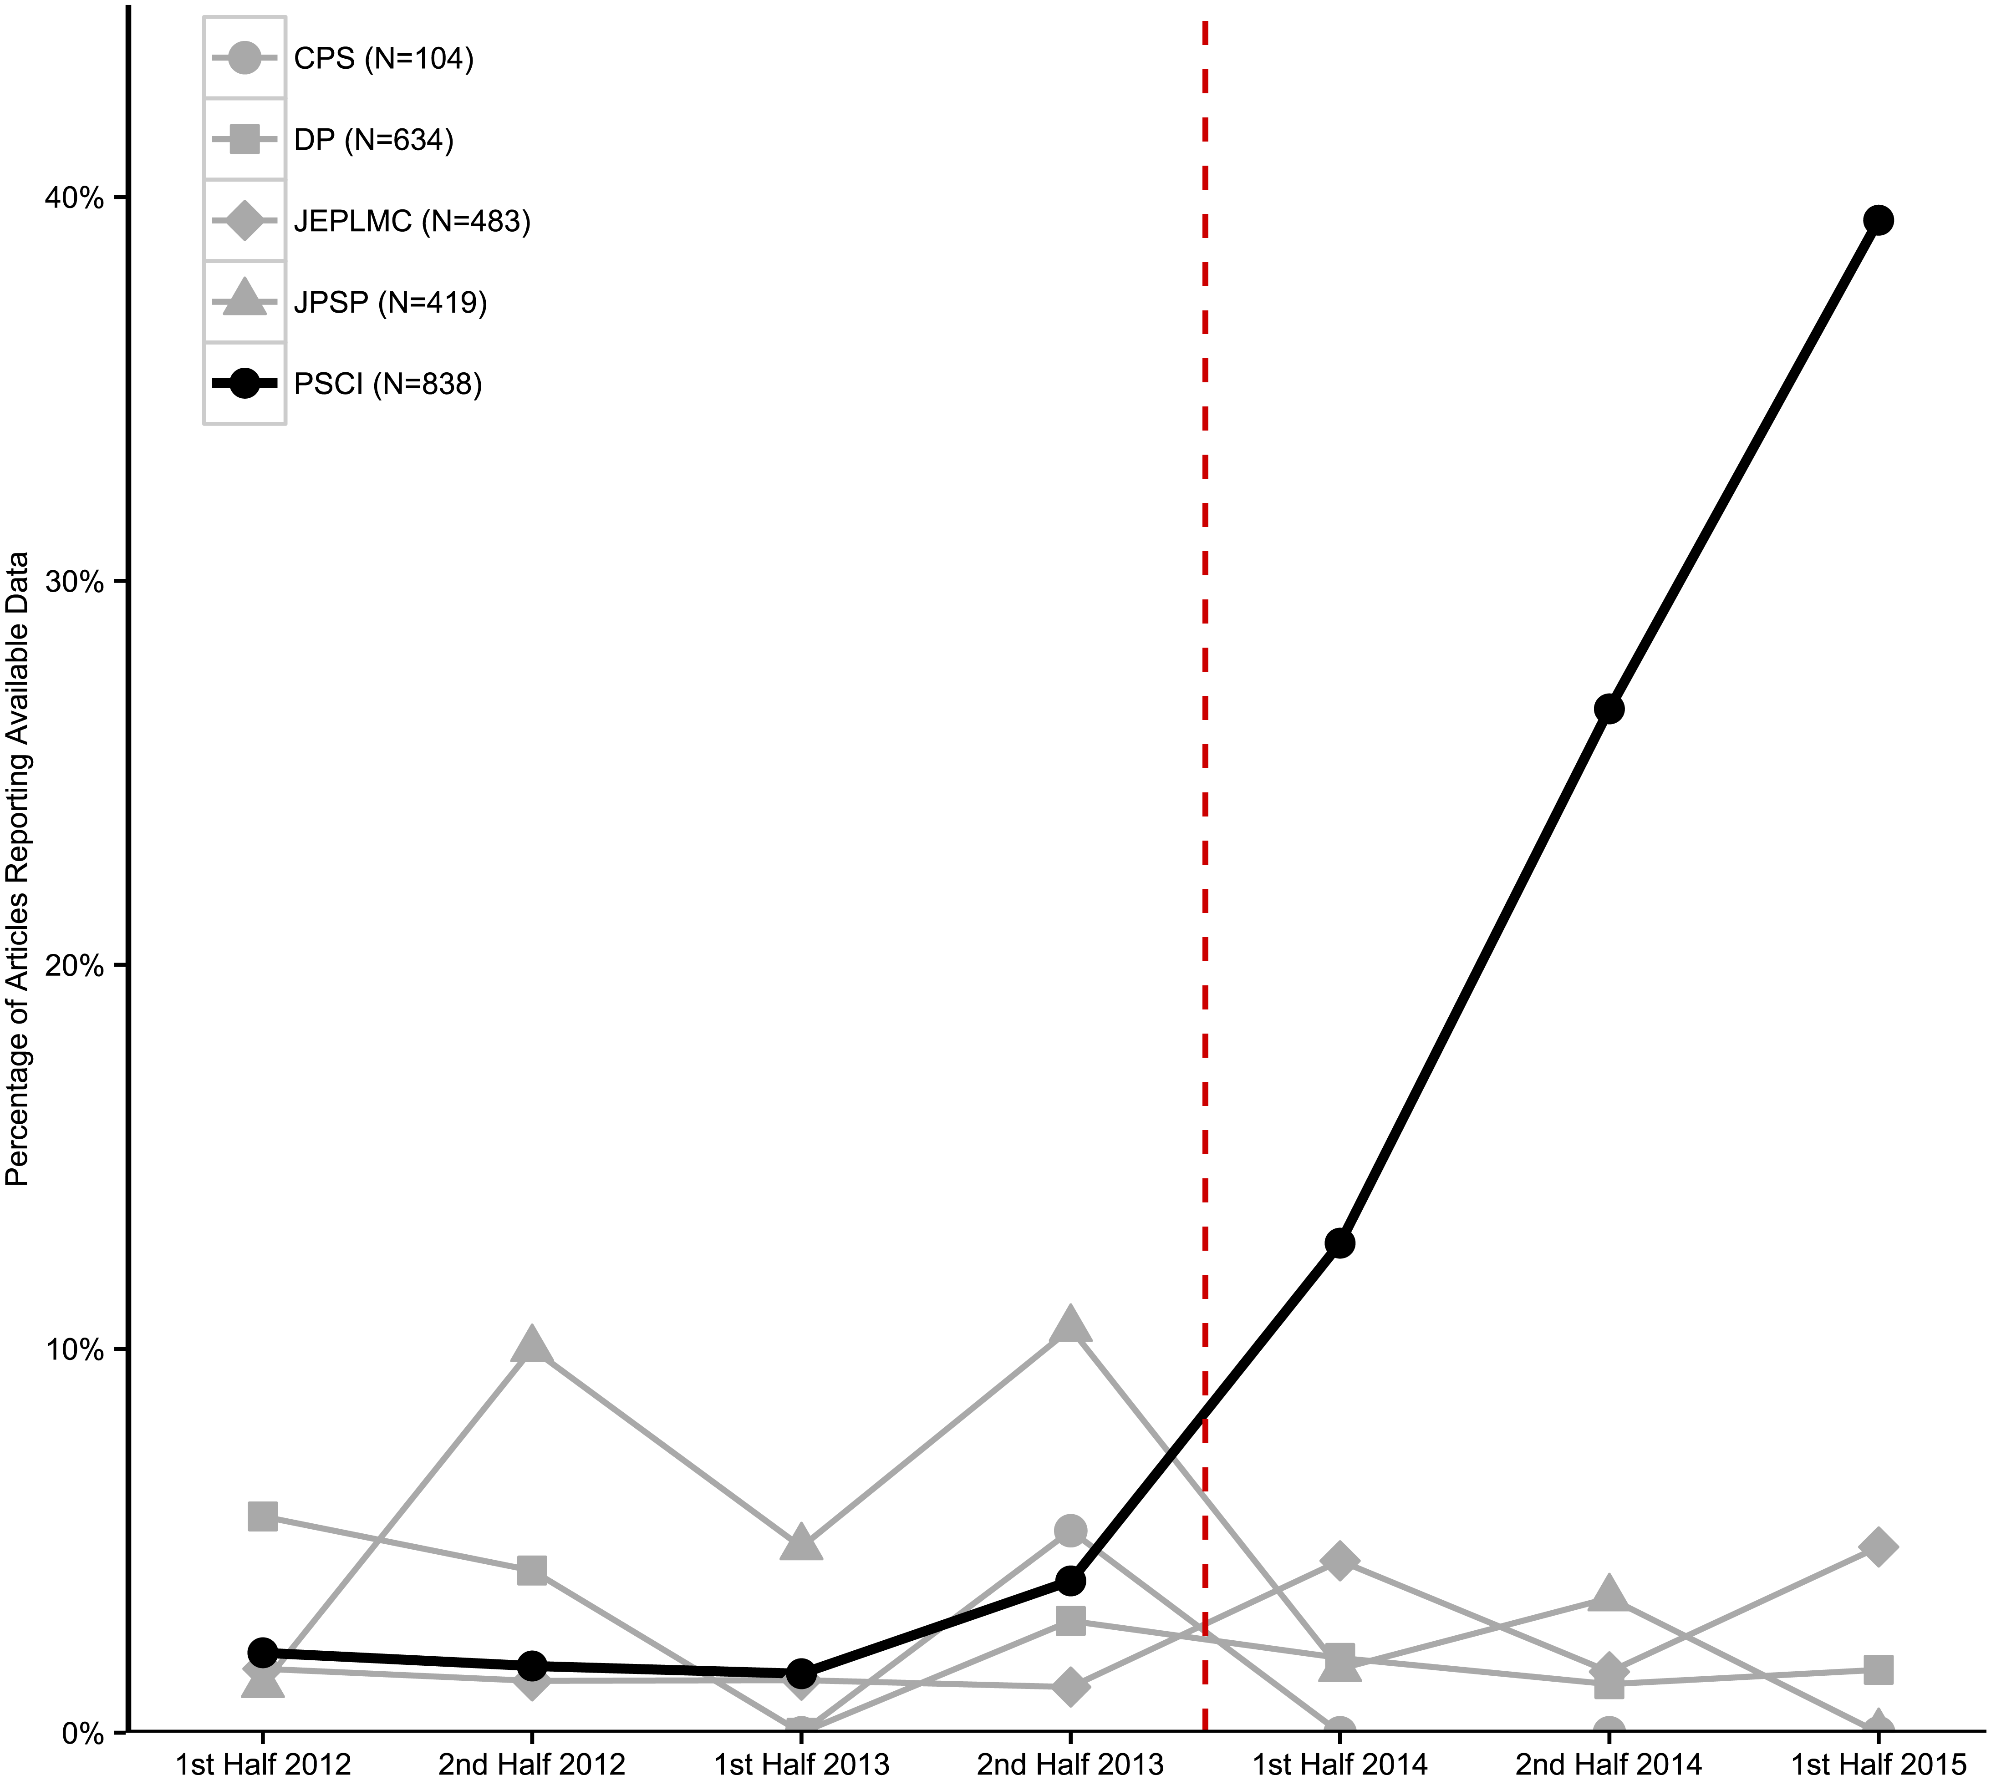
PLOS Biology, 2016; https://doi.org/10.1371/journal.pbio.1002456.g002
Notes:
But the COS have performed some research to explore this: introducing these open data badges at a psychology journal (Psychological Science, marked by the dotted line) was associated with an increase in the number of papers where data was reported to be available

Slide 36
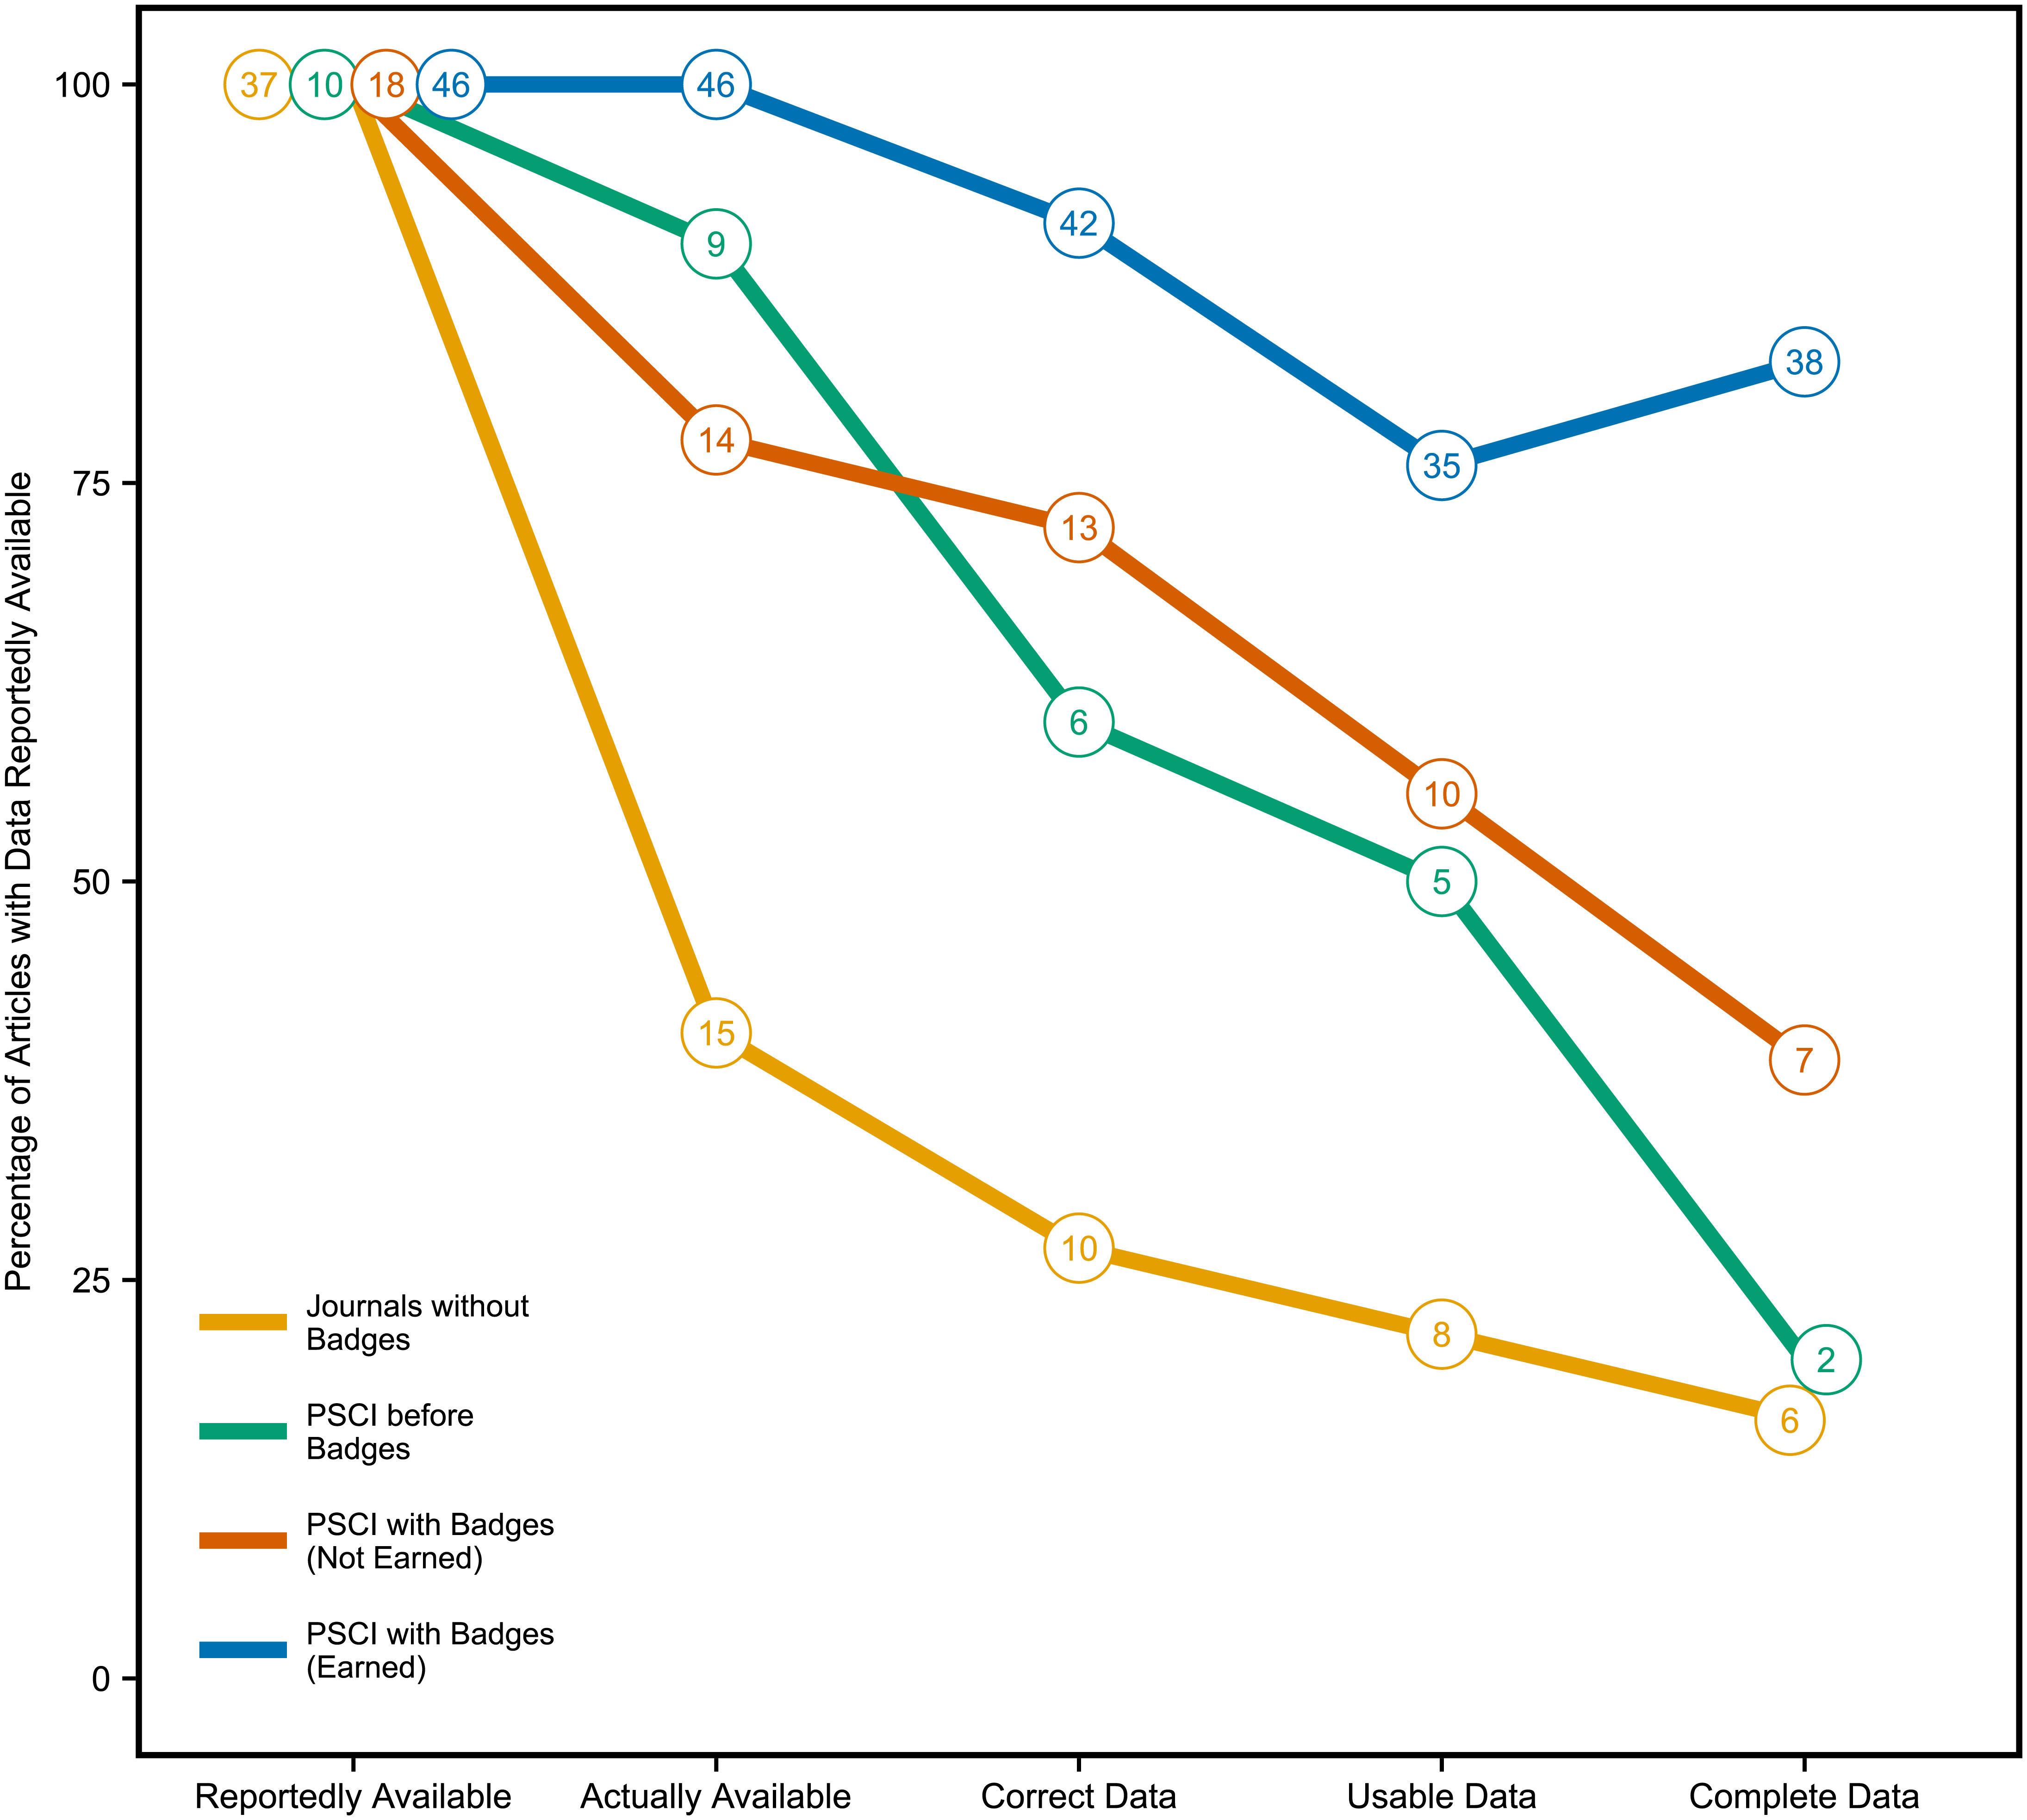
PLOS Biology, 2016; https://doi.org/10.1371/journal.pbio.1002456.g002
Notes:
and this data was not only available more often, but the quality of it (usability, completeness) was also improved after the introduction of the badges (blue line).

Slide 37
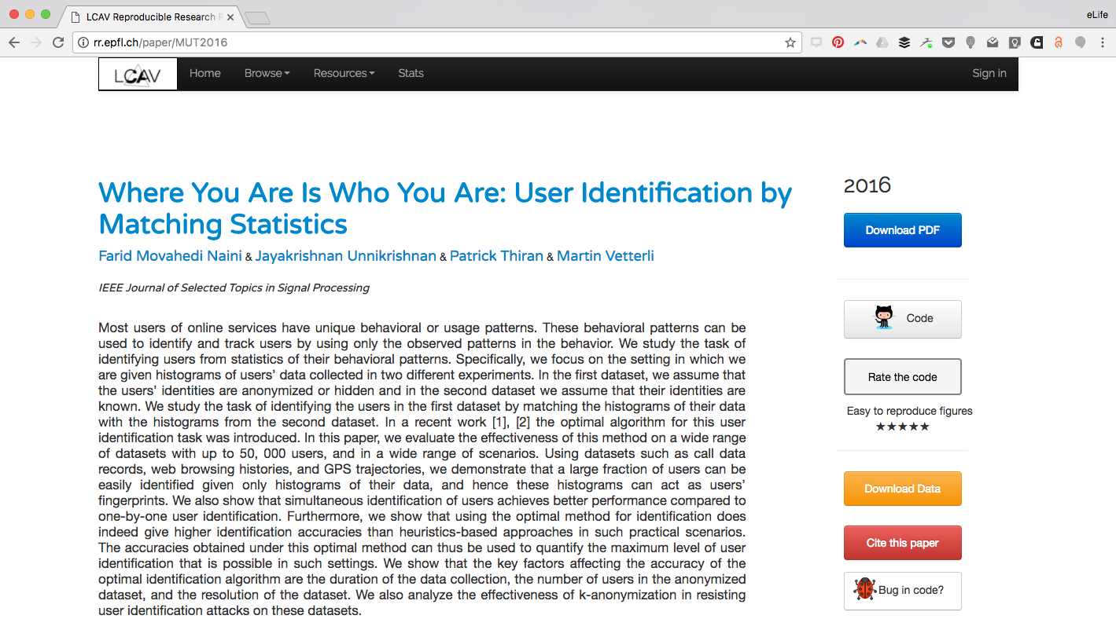
Publish
Describe
Interact
Reproduce
Update
Recognise
Link
Notes:
There have been efforts to incentivise and assess the value of sharing from researchers themselves. Here, Prof Martin Vetterli’s group at EPFL, Lausanne, maintain an online site with their papers, and the associated code and data. They have a rating system, …

Slide 38
Notes:
There have been efforts to incentivise and assess the value of sharing from researchers themselves. Here, Prof Martin Vetterli’s group at EPFL, Lausanne, maintain an online site with their papers, and the associated code and data. They have a rating system, …

Slide 39
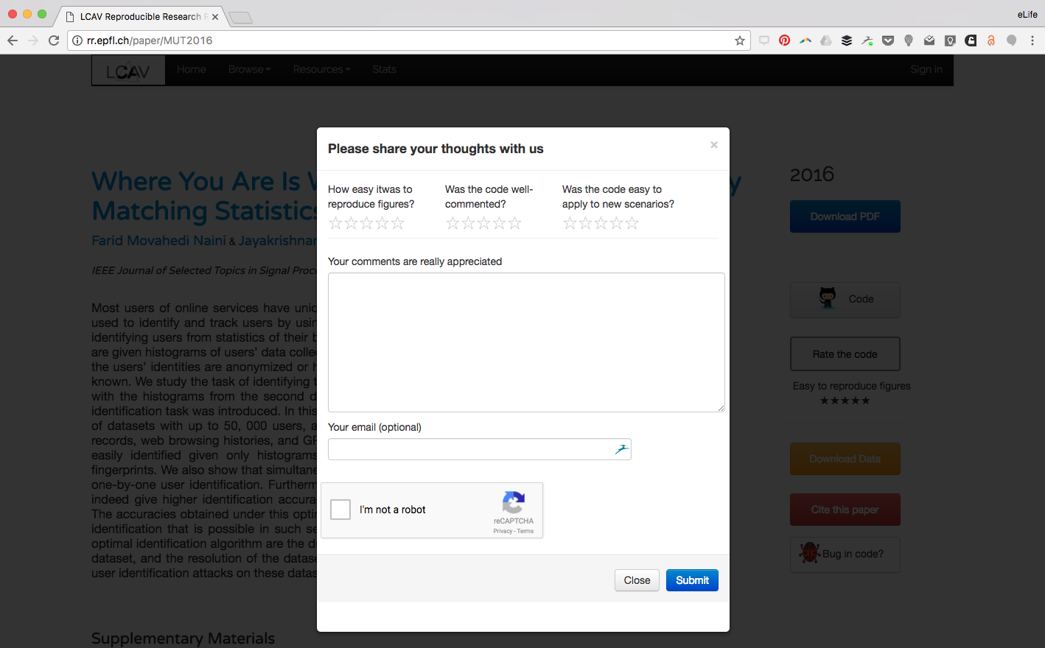
Notes:
where readers are asked to feedback on the reusability and quality of the data and code

Slide 40
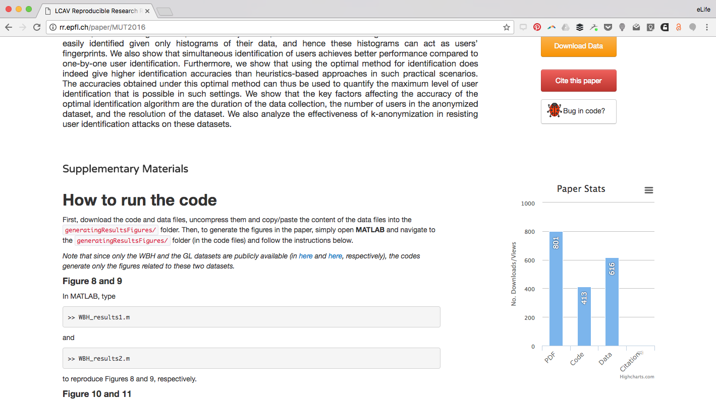
Notes:
plus they measure the impact of their work through a downloads graph here – for the pdf, data and code.

Slide 41
Connecting projects
Linked open data
Human curation
Publish
Describe
Interact
Reproduce
Update
Recognise
Link
Notes:
Moving beyond the single publication, there are efforts to connect up related research and open datasets – which will help with reproducibility and gaining further value from these data. Some of these efforts are aimed at machines

Slide 42
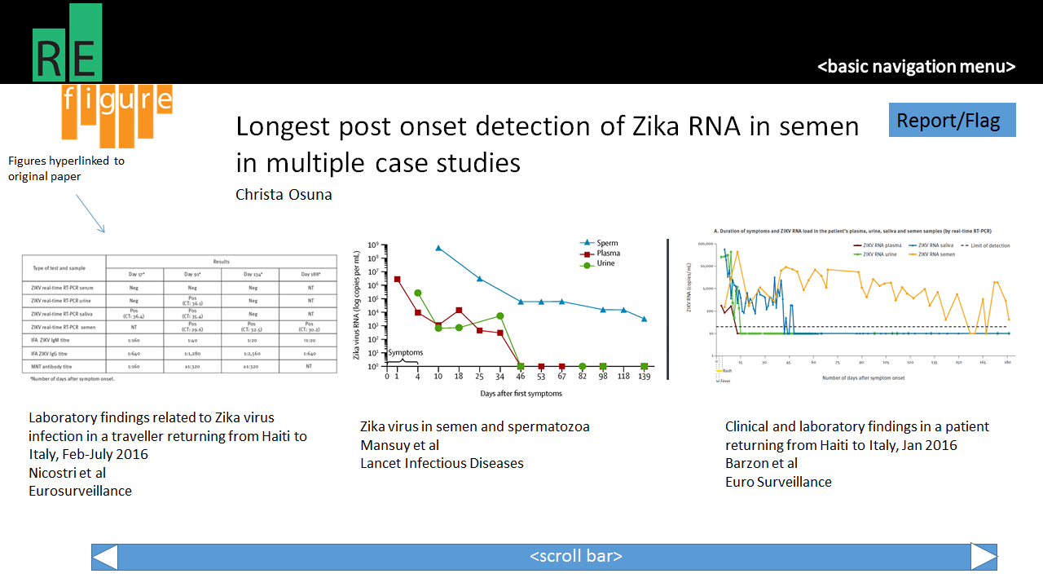
ReFigure
http://refigure.org/index.html
Notes:
and some at humans. Girija Goyal and James Akin. Chrome extension to collect together figures relating to similar hypotheses – to demonstrate reproducibility of a finding, or not.

Slide 43
Where next?
@eLifeInnovation
innovation@elifesciences.org
Notes:
Exciting times – benefits, tools, opportunities. But where next?

Slide 44
Publisher constraints
Static version of peer-reviewed article
Persistence
Accuracy
Who stores? Who hosts? Who computes?
…and researcher practises
Notes:
All examples so far are experimental, it’s a really exciting time to get involved as we explore how these experiments might become more commonplace.
Keep in mind the challenges:
Need a static version of peer-review article, to ensure preservation of the process. Any derivative must be kept distinct from the original.
Responsible for persistence and accuracy of any enhancements – efforts to require data review during peer review are only just beginning
Storage and hosting – who pays for it?

Slide 45




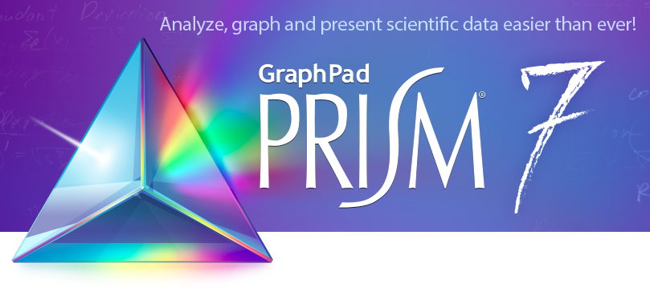
RESEARCHER PRACTISES
Notes:
As Adam Hyde was speaking about – need to own the itch, own the problem, understand the user.
Bear in mind that researchers using the more computational tools currently don’t benefit from this effort when it gets to publishing. We’d like to streamline the process, save them time.

Slide 46
Outstanding issues
Improve quality of data sharing
Incentives
“No time or funding” to learn new tools, document data well
“No benefit”
Notes:
Heard in several talks yesterday – sharing is not enough, needs to be reusable
Continuous integration (Mietchen)
Individual benefit to doing it and support (time, money)
higher citations
collaborations
sometimes none
sometimes negative effect on the individual
It also leads to higher citation rates (an average of 14% increase). But for 40% of researchers, no direct benefit was reported. But negative consequences are rare: 1 in 20 researchers reported a bad effect, such as being scooped, incorrect reuse of their data, the burden of spending time supporting others to reuse their data, and not receiving appropriate acknowledgement when their data is reused.
These bad effects contribute to the hesitation in fully embracing the possibilities of open research data: there's a fear of misuse, misattribution, scooping. But it's also difficult: few researchers start a project with open data in mind, so arranging it for publication at the end requires time and effort, both precious resources when time is needed to compete for grants. To help encourage researchers to spend this time and effort, they would like to have funding set aside for data preparation, and for open data publication to be taken into account in funding and career decisions. And they'd like practising open research to help enhance their academic reputation, as well as to know how others are using their work.
It seems most researchers are net beneficiaries of open science: they take out more than they put in, with only 25% saying they have never reused existing data. When judging whether data is suitable for reuse, researchers look for a reputable author, and well-documented high-quality datasets.

Slide 47
Opportunities
Facilitating data sharing via the journal means:
Persistence
Leverages incentive system
Streamline the process from initial discovery to replication
Engages community
Doing it open source means:
Progress can be shared
Stimulates further innovation
Engages community
Notes:
Community: at the top and the bottom (senior and ECRs)
We support the development of open-source tools, with extensible capabilities, that can be used, adopted and modified by any interested party to help move towards an ecosystem that serves science and scientists as efficiently and as cost-effectively as possible.

Slide 48
Your thoughts?
Naomi Penfold, Innovation Officer
@eLifeInnovation
Email: innovation@elifesciences.org
Slides: github.com/npscience/csvconfv3-presentation
Notes:
Reproducible research – how can we help life scientists document their work more easily? How can we better demonstrate the value of sharing data and methods, beyond these case studies? how can we incentivise researchers to commit the time and effort required to do this?
Set purpose/expectation: I’d like to hear more from you – do you have ideas or projects that could help us achieve these goals? can we help support you to develop these ideas? have I missed anything, can you help fill any gaps I have?

Slide 49
“The impact we cherish is discovery in science”
Randy Schekman, eLife Editor-in-Chief

